Slide 1


Slide 2
TestNG
TestNG stands for “Test Next Generation”
TestNG is a unit testing framework basically used by developers while doing white box testing.

Slide 3
Steps to download TestNG
1.Open the eclipse
2.Click on Help and select install new software

Slide 4
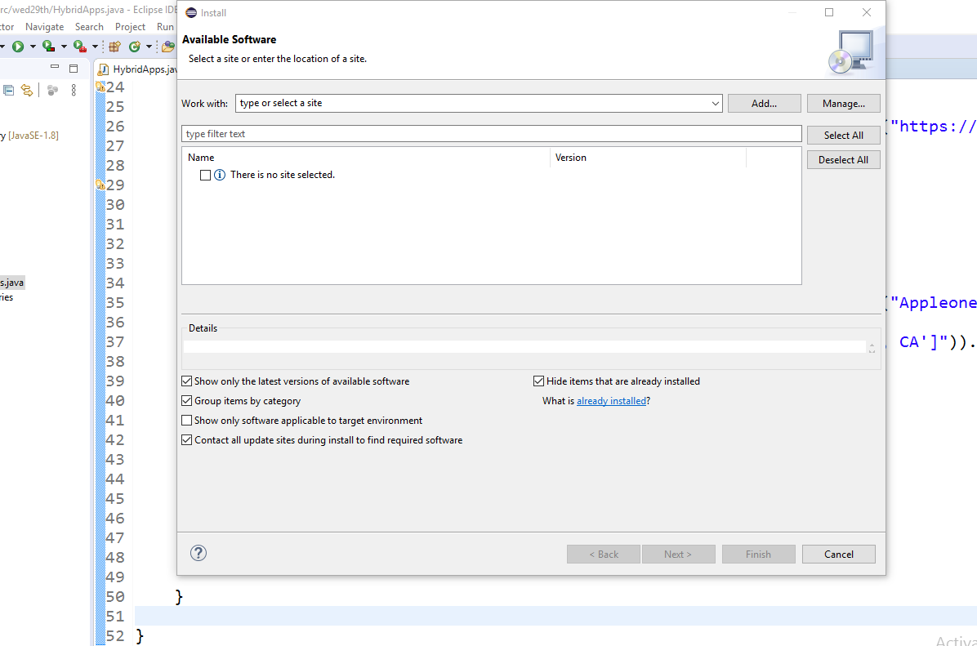
Click on Add button

Slide 5
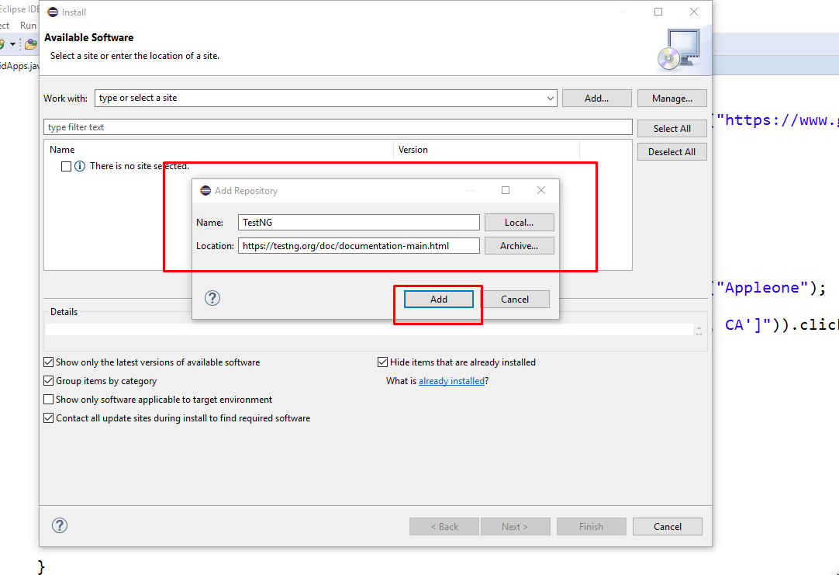
Paste the Link and click on add button

Slide 6
Note:
1.Accept the Licence
2.Click on Next-→Next-→Finish

Slide 7
To Verify TestNG is installed or Not
1.Right Click on project
2.Check TestNG option should be present

Slide 8
Steps to attach TestNG to Project
1.Right click on project
2.Select the build path
3.Click on add libraries
4.Select TestNG
5.Click on Next
6.Click on Finish

Slide 9
TestNG Class
It is a java class which contains the test method
What is Test Method..?
Any method which is developed by using test Annotations(@Test)
Is called as test method.

Slide 10
Example:
package testng;
import org.testng.Reporter;
import org.testng.annotations.Test;
public class Sample {
@Test
public void abc()
{
Reporter.log("hello",false);
}
}

Slide 11
Annotations Of TestNG
@BeforeSuite: The annotated method will be run before all tests in this suite have run.
@AfterSuite: The annotated method will be run after all tests in this suite have run.
@BeforeTest: The annotated method will be run before any test method belonging to the classes inside the <test> tag is run.
@AfterTest: The annotated method will be run after all the test methods belonging to the classes inside the <test> tag have run.

Slide 12
@BeforeClass: The annotated method will be run before the first test method in the current class is invoked.
@AfterClass: The annotated method will be run after all the test methods in the current class have been run.
@BeforeMethod: The annotated method will be run before each test method.
@AfterMethod: The annotated method will be run after each test method.

Slide 13
Example for Annotations
package testng;
import org.testng.Reporter;
import org.testng.annotations.AfterClass;
import org.testng.annotations.AfterMethod;
import org.testng.annotations.AfterSuite;
import org.testng.annotations.AfterTest;
import org.testng.annotations.BeforeClass;
import org.testng.annotations.BeforeMethod;
import org.testng.annotations.BeforeSuite;
import org.testng.annotations.BeforeTest;
import org.testng.annotations.Test;

Slide 14
public class Demo1 {
@BeforeSuite
public void bs()
{
Reporter.log("Beforesuite",true);
}
@AfterSuite
public void as()
{
Reporter.log("Aftersuite",true);
}

Slide 15
@BeforeTest
public void bt()
{
Reporter.log("Beforetest",true);
}
@AfterTest
public void at()
{
Reporter.log("Aftertest",true);
}

Slide 16
@BeforeMethod
public void am()
{
Reporter.log("beforemethod",true);
}
@AfterMethod
public void af()
{
Reporter.log("Aftermethod",true);
}

Slide 17
@BeforeClass
public void bc()
{
Reporter.log("beforeclass",true);
}
@AfterClass
public void ac() {
Reporter.log("Afterclass",true);}
@Test
public void testmethod(){
Reporter.log("Test",true);
}

Slide 18
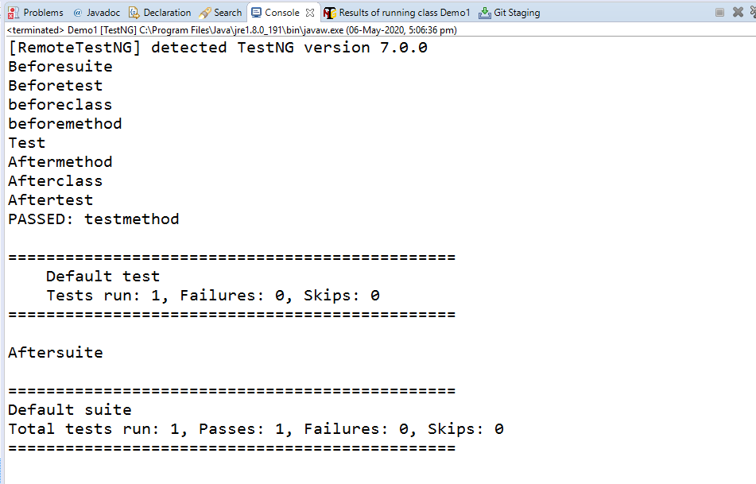
Output

Slide 19
Execution of Testmethods in Required Order
By using Priority
@Test(Priority=1)
Default Priority is Zero
If two methods are have same priority then those methods are executed in Alphabetical order.
Priority value can be negative number as well.

Slide 20
Example
package testng;
import org.testng.Reporter;
import org.testng.annotations.Test;
public class Whatsapp {
@Test(priority = 1)
public void calls()
{
Reporter.log("calls",true);
}

Slide 21
@Test
public void settings()
{
Reporter.log("setting",true);
}
@Test(priority = 1)
public void chats()
{
Reporter.log("chats",true);
}}

Slide 22
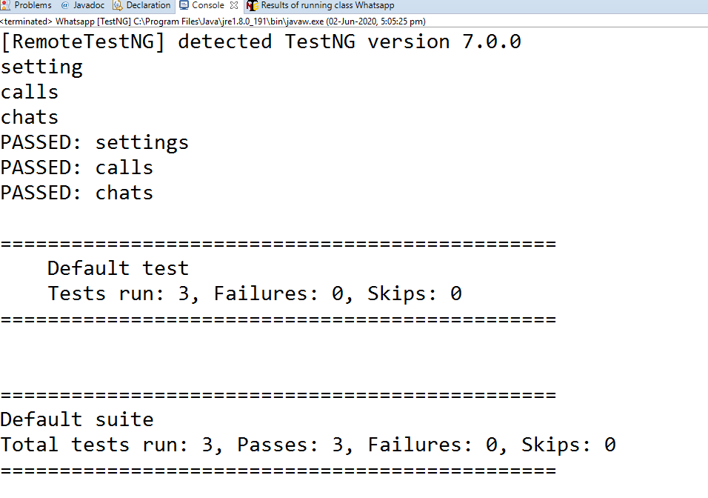

Output

Slide 23
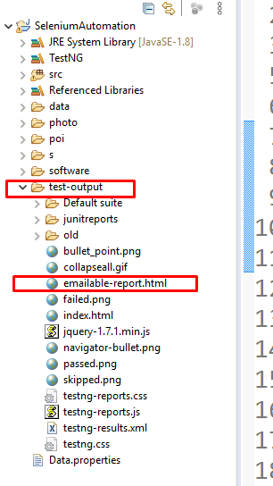

Steps to Generate Report
Once after execution is completed refresh the project you find test output folder
Click on emailable-report.html

Slide 24
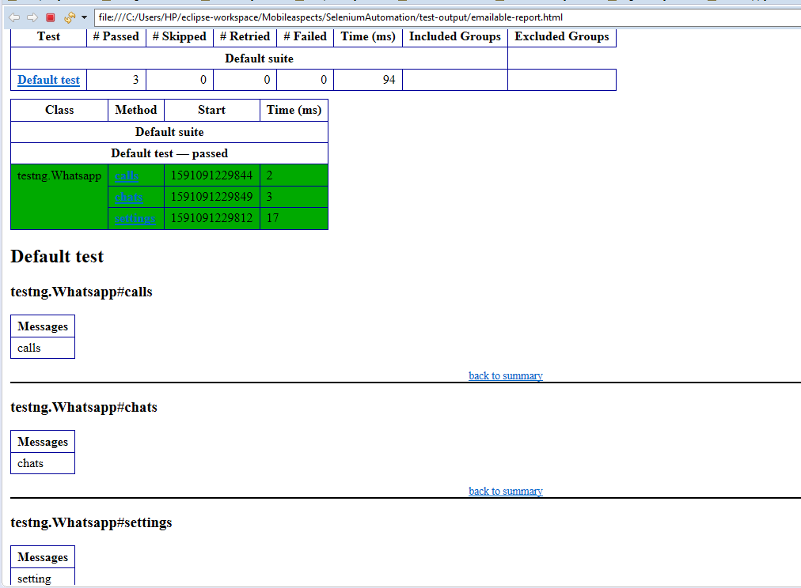

Report

